Slide 1

Database Systems:
Design, Implementation, and Management
Tenth Edition
Chapter 8
Advanced SQL

Slide 2
Objectives
In this chapter, you will learn:
  How to use the advanced SQL JOIN operator syntax
  About the different types of subqueries and correlated queries
  How to use SQL functions to manipulate dates, strings, and other data
  About the relational set operators UNION, UNION ALL, INTERSECT, and MINUS
Database Systems, 10th Edition

Slide 3
Objectives (cont’d.)
  How to create and use views and updatable views
  How to create and use triggers and stored procedures
  How to create embedded SQL
Database Systems, 10th Edition

Slide 4
SQL Join Operators
Join operation merges rows from two tables and returns the rows with one of the following:
  Have common values in common columns
    Natural join
  Meet a given join condition
    Equality or inequality
  Have common values in common columns or have no matching values
    Outer join
Inner join: only returns rows meeting criteria
Database Systems, 10th Edition

Slide 5
Cross Join
Performs relational product of two tables
  Also called Cartesian product
Syntax:
  SELECT column-list FROM table1 CROSS JOIN table2
Perform a cross join that yields specified attributes
Database Systems, 10th Edition

Slide 6
Natural Join
Returns all rows with matching values in the matching columns
  Eliminates duplicate columns
Used when tables share one or more common attributes with common names
Syntax:
  SELECT column-list FROM table1 NATURAL JOIN table2
Database Systems, 10th Edition

Slide 7
JOIN ON Clause
Used when tables have no common attributes
Returns only rows that meet the join condition
  Typically includes equality comparison expression of two columns
Syntax:
  SELECT column-list FROM table1 JOIN table2 ON join-condition
Database Systems, 10th Edition

Slide 8
Join On Example
select e.emp_num, e.emp_name, e.dep_num, d.dep_number, d.dep_name
from employee e join department d
on e.dep_num = d.dep_number;
Notice: different spellings for department number
Database Systems, 10th Edition

Slide 9
JOIN USING Clause
Returns only rows with matching values in the column indicated in the USING clause
Syntax:
  SELECT column-list FROM table1 JOIN table2 USING (common-column)
JOIN USING operand does not require table qualifiers
  Oracle returns error if table name is specified
Database Systems, 10th Edition

Slide 10
Join Using Example
select e.emp_num, e.emp_name, dep_num, d.dep_name
from employee e join department d
using (dep_num);
Notice: Columns must be spelled the same way
Database Systems, 10th Edition

Slide 11
Outer Joins
Returns rows matching the join condition
Also returns rows with unmatched attribute values for tables to be joined
Three types
  Left
  Right
  Full
Left and right designate order in which tables are processed
Database Systems, 10th Edition

Slide 12
Outer Joins (cont’d.)
Left outer join
  Returns rows matching the join condition
  Returns rows in left side table with unmatched values
  Syntax: SELECT column-list FROM table1 LEFT [OUTER] JOIN table2 ON join-condition
Right outer join
  Returns rows matching join condition
  Returns rows in right side table with unmatched values
Database Systems, 10th Edition

Slide 13
Outer Joins (cont’d.)
Full outer join
  Returns rows matching join condition
  Returns all rows with unmatched values in either side table
  Syntax:
    SELECT column-list
    FROM table1 FULL [OUTER] JOIN table2
    ON join-condition
Database Systems, 10th Edition

Slide 14
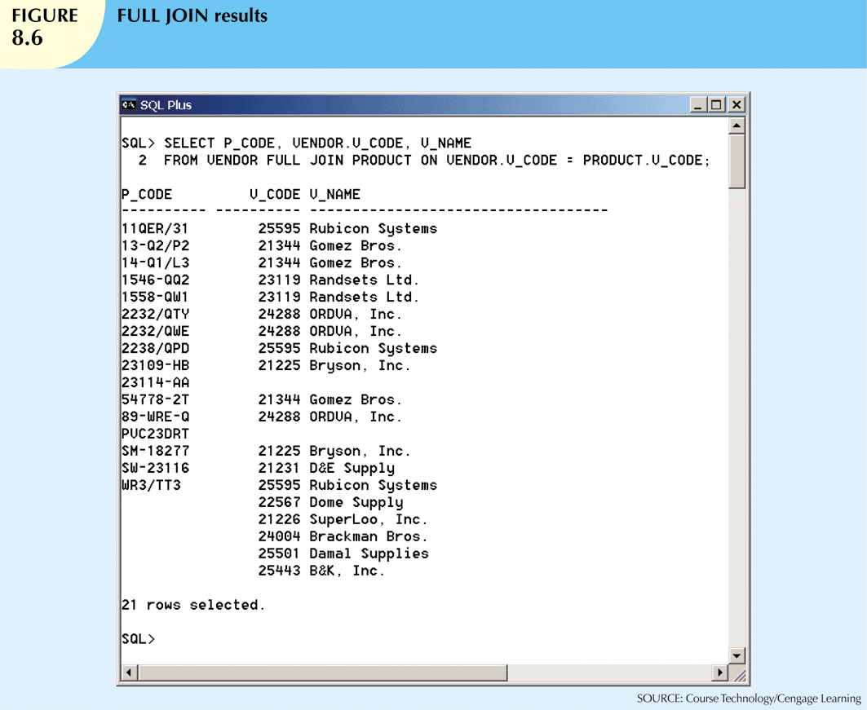
Database Systems, 10th Edition

Slide 15
Subqueries and Correlated Queries
Often necessary to process data based on other processed data
Subquery is a query inside a query, normally inside parentheses
First query is the outer query
  Inside query is the inner query
Inner query is executed first
Output of inner query is used as input for outer query
Sometimes referred to as a nested query
Database Systems, 10th Edition

Slide 16
WHERE Subqueries
Most common type uses inner SELECT subquery on right side of WHERE comparison
  Requires a subquery that returns only one single value
Value generated by subquery must be of comparable data type
Can be used in combination with joins
Database Systems, 10th Edition

Slide 17
Example without subquery
select dep_num from department
where dep_name = 'Sales' or
dep_name = 'Mktg';
[ Result 101 102 ]
select * from employee e, department d
where
e.dep_num = d.dep_num and
e.dep_num in (101, 102);
Database Systems, 10th Edition

Slide 18
Example with subquery
select * from employee e, department d
where
e.dep_num = d.dep_num and
e.dep_num in (
select dep_num from department
where dep_name = 'Sales' or
dep_name = 'Mktg');
Database Systems, 10th Edition

Slide 19
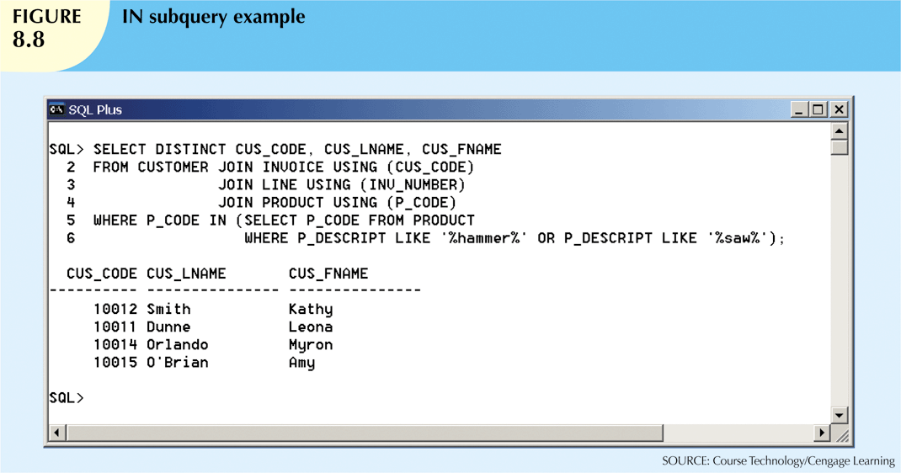
IN Subqueries
Used when comparing a single attribute to a list of values
Database Systems, 10th Edition

Slide 20
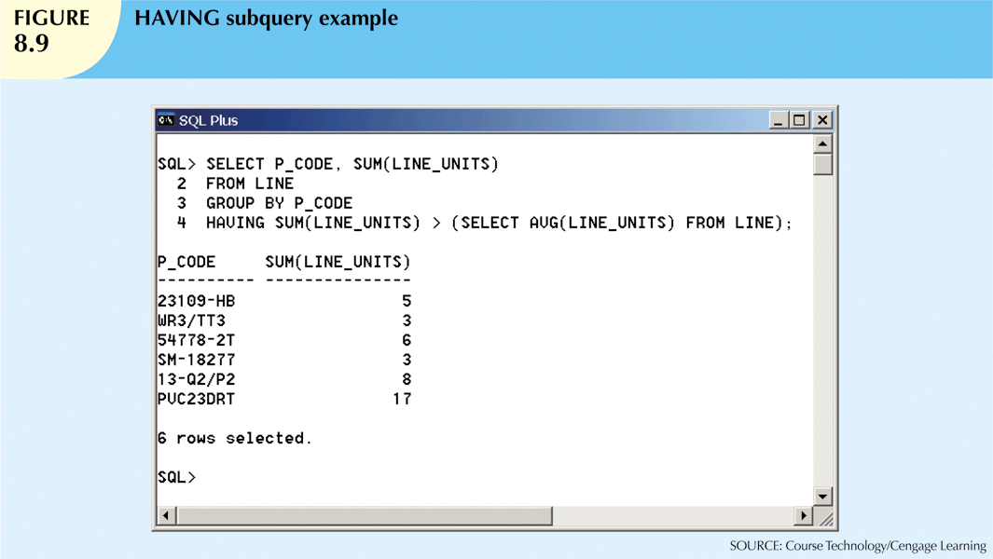
HAVING Subqueries
HAVING clause restricts the output of a GROUP BY query
  Applies conditional criterion to the grouped rows
Database Systems, 10th Edition

Slide 21
Multirow Subquery Operators:
ANY and ALL
Allows comparison of single value with a list of values using inequality comparison
“Greater than ALL” equivalent to “greater than the highest in list”
“Less than ALL” equivalent to “less than lowest”
Using equal to ANY operator equivalent to IN operator
Database Systems, 10th Edition

Slide 22
Any and All examples
select * from employee
where emp_num > any (1005, 2005);
select * from employee
where emp_num > all (1005, 2005);
Database Systems, 10th Edition

Slide 23
FROM Subqueries
Specifies the tables from which the data will be drawn
Can use SELECT subquery in the FROM clause
  View name can be used anywhere a table is expected
Database Systems, 10th Edition

Slide 24
FROM subquery example
select * from (
select emp_num, emp_name, job_code
from employee);
Database Systems, 10th Edition

Slide 25
FROM subquery examples
select * from (
select emp_num, emp_name, dep_num
from employee
WHERE dep_num = 101);
select * from (
select emp_num, emp_name, dep_num
from employee)
WHERE dep_num = 101;
Database Systems, 10th Edition

Slide 26
Attribute List Subqueries
SELECT statement uses attribute list to indicate columns to project resulting set
  Columns can be attributes of base tables
  Result of aggregate function
Attribute list can also include subquery expression: inline subquery
  Must return one single value
Cannot use an alias in the attribute list
Database Systems, 10th Edition

Slide 27
Attribute Subquery Example
select emp_num, emp_name, salary,
(select avg(salary) from employee)
as AvgSalary
from employee;
Database Systems, 10th Edition

Slide 28
Correlated Subqueries
Subquery that executes once for each row in the outer query
Correlated because inner query is related to the outer query
  Inner query references column of outer subquery
Can also be used with the EXISTS special operator
Database Systems, 10th Edition

Slide 29
Correlated Subquery Example
select emp_num, emp_name from employee e
where salary >
(select avg(salary) from employee
where dep_num = e.dep_num);
Notice inner “where” depends on outer row
Subquery is repeated for each outer row
Database Systems, 10th Edition

Slide 30
-- Correlated Subquery Example
EMP_NUM EMP_NAME DEP_NUM SALARY JOB_CODE
---------- -------- ---------- ---------- ----------
1001 John 101 22.5 55
2002 Frank 101 44.5 56
3003 Bill 102 33.5 77
4004 Hank 33.5 77
select emp_num, emp_name from employee e
where salary >
(select avg(salary) from employee
where dep_num = e.dep_num);
EMP_NUM EMP_NAME
---------- --------
2002 Frank
Database Systems, 10th Edition

Slide 31
SQL Functions
Generating information from data often requires many data manipulations
SQL functions are similar to functions in programming languages
Functions always use numerical, date, or string value
Value may be part of a command or attribute in a table
Function may appear anywhere in an SQL statement
Database Systems, 10th Edition

Slide 32
Date and Time Functions
All SQL-standard DBMSs support date and time functions
Date functions take one parameter and return a value
Date/time data types are implemented differently by different DBMS vendors
ANSI SQL standard defines date data types, but not how data types are stored
Database Systems, 10th Edition

Slide 33
Date and time examples
Create Table DTab (a int, b date);
Insert Into DTab Values (101, sysdate);
Insert Into DTab Values (102,
cast ('05-May-2005' as DATE));
Insert Into DTab Values (103,
to_date ('2005/05/05', 'yyyy/mm/dd'));
Insert Into DTab Values (104,
to_date ('050505','mmddyy'));
Insert Into DTab Values (105,
to_date ('20050505','yyyymmdd'));
Database Systems, 10th Edition

Slide 34
Numeric Functions
Grouped in different ways
  Algebraic, trigonometric, logarithmic, etc.
Do not confuse with aggregate functions
  Aggregate functions operate over sets
  Numeric functions operate over single row
Numeric functions take one numeric parameter and return one value
Database Systems, 10th Edition

Slide 35
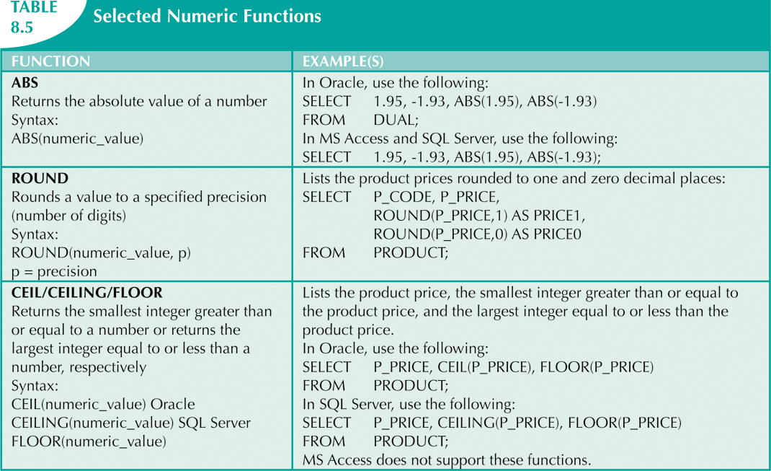
Database Systems, 10th Edition

Slide 36
String Functions
String manipulations are the most used functions in programming
String manipulation function examples:
  Concatenation
  Printing in uppercase
  Finding length of an attribute
Database Systems, 10th Edition

Slide 37
Conversion Functions
Take a value of given data type and convert it to the equivalent value in another data type
Oracle conversion functions:
  TO_CHAR: takes a date value, converts to character string
  TO_DATE: takes character string representing a date, converts it to actual date in Oracle format
SQL Server uses CAST and CONVERT functions
Database Systems, 10th Edition

Slide 38
Relational Set Operators
UNION
INTERSECT
MINUS
Work properly if relations are union-compatible
  Names of relation attributes must be the same and their data types must be identical
Database Systems, 10th Edition

Slide 39
UNION
Combines rows from two or more queries without including duplicate rows
  Example:
    SELECT CUS_LNAME, CUS_FNAME, CUS_INITIAL, CUS_AREACODE,
    FROM CUSTOMER
    UNION
    SELECT CUS_LNAME, CUS_FNAME, CUS_INITIAL, CUS_AREACODE,
    FROM CUSTOMER_2
Can be used to unite more than two queries
Database Systems, 10th Edition

Slide 40
UNION ALL
Produces a relation that retains duplicate rows
  Example query:
  SELECT CUS_LNAME, CUS_FNAME, CUS_INITIAL, CUS_AREACODE, FROM CUSTOMER
  UNION ALL
  SELECT CUS_LNAME, CUS_FNAME, CUS_INITIAL, CUS_AREACODE, FROM CUSTOMER_2;
Can be used to unite more than two queries
Database Systems, 10th Edition

Slide 41
INTERSECT
Combines rows from two queries, returning only the rows that appear in both sets
Syntax: query INTERSECT query
  Example query:
  SELECT CUS_LNAME, CUS_FNAME, CUS_INITIAL, CUS_AREACODE, FROM CUSTOMER
  INTERSECT
  SELECT CUS_LNAME, CUS_FNAME, CUS_INITIAL, CUS_AREACODE, FROM CUSTOMER_2
Database Systems, 10th Edition

Slide 42
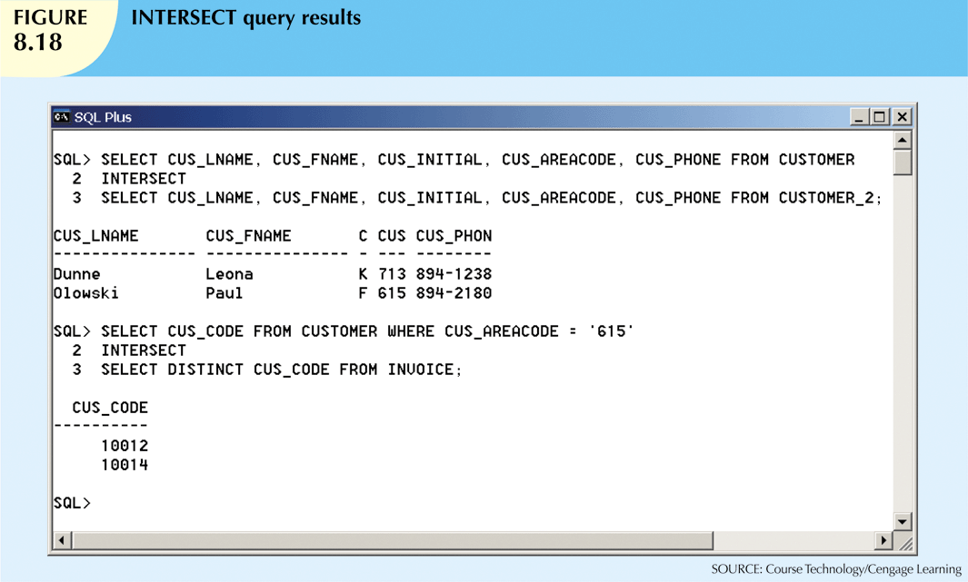
Database Systems, 10th Edition

Slide 43
MINUS
Combines rows from two queries
  Returns only the rows that appear in the first set but not in the second
Syntax: query MINUS query
  Example:
  SELECT CUS_LNAME, CUS_FNAME, CUS_INITIAL, CUS_AREACODE, FROM CUSTOMER
  MINUS
  SELECT CUS_LNAME, CUS_FNAME, CUS_INITIAL, CUS_AREACODE, FROM CUSTOMER_2
Database Systems, 10th Edition

Slide 44
Syntax Alternatives
IN and NOT IN subqueries can be used in place of INTERSECT
Example:
  SELECT CUS_CODE FROM CUSTOMER
  WHERE CUS_AREACODE = ‘615’ AND
  CUS_CODE IN (SELECT DISTINCT CUS_CODE
  FROM
  INVOICE);
Database Systems, 10th Edition

Slide 45
Virtual Tables: Creating a View
View: Virtual table based on a SELECT query
Base tables: Tables on which the view is based
CREATE VIEW view_name AS SELECT query
A view provides a window into a base table
Database Systems, 10th Edition

Slide 46
View example
CREATE VIEW employee_view AS
SELECT enum, ename, department, jobcode
FROM employee;
SELECT * FROM employee_view;
Notice: employee view has no salary information
Database Systems, 10th Edition

Slide 47
Updatable Views
Updatable view is a view that can be used to update attributes in the base tables
Not all views are updatable
  GROUP BY expressions or aggregate functions cannot be used
  Cannot use set operators
  Most restrictions are based on use of JOINs
Database Systems, 10th Edition

Slide 48
Update View Problem
Create View All_Emps AS
SELECT * FROM NY_Employees UNION
SELECT * FROM LA_Employees
INSERT INTO All_Emps VALUES (
1103, ‘Kelly', ‘Sales' , 84.50, 23.80);
Does Kelly go into:
NY_Employees or LA Employees?
Database Systems, 10th Edition

Slide 49
Oracle Sequences
MS Access AutoNumber data type fills a column with unique numeric values
Oracle sequences
  Independent object in the database
  Named, used anywhere a value expected
  Not tied to a table or column
  Generate numeric values that can be assigned to any column in any table
  Created and deleted at any time
Database Systems, 10th Edition

Slide 50
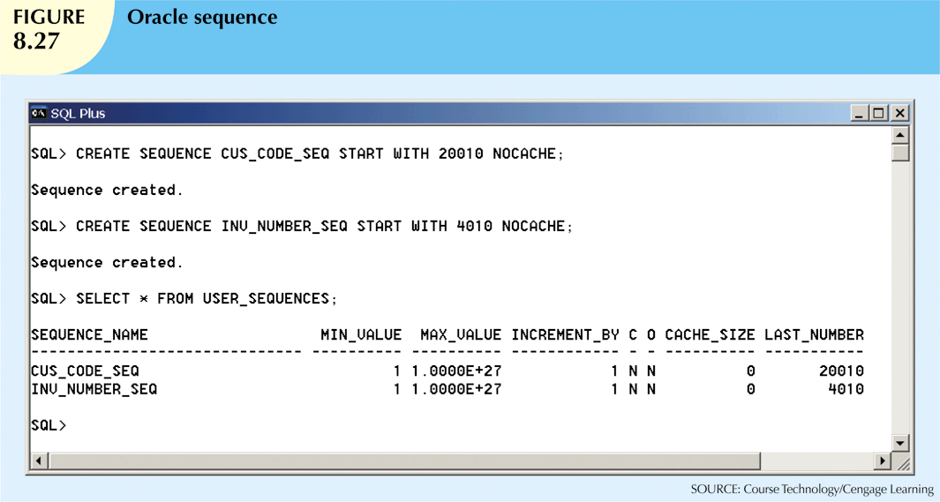
Database Systems, 10th Edition

Slide 51
Procedural SQL
SQL does not support conditional execution
Isolate critical code
  All applications access shared code
  Better maintenance and logic control
Persistent stored module (PSM) is a block of code containing:
  Standard SQL statements
  Procedural extensions
  Stored and executed at the DBMS server
Database Systems, 10th Edition

Slide 52
Procedural SQL (cont’d.)
Procedural SQL (PL/SQL) enables you to:
  Store procedural code and SQL statements in database
  Merge SQL and traditional programming constructs
Procedural code executed by DBMS when invoked by end user
  Anonymous PL/SQL blocks and triggers
  Stored procedures and PL/SQL functions
Database Systems, 10th Edition

Slide 53
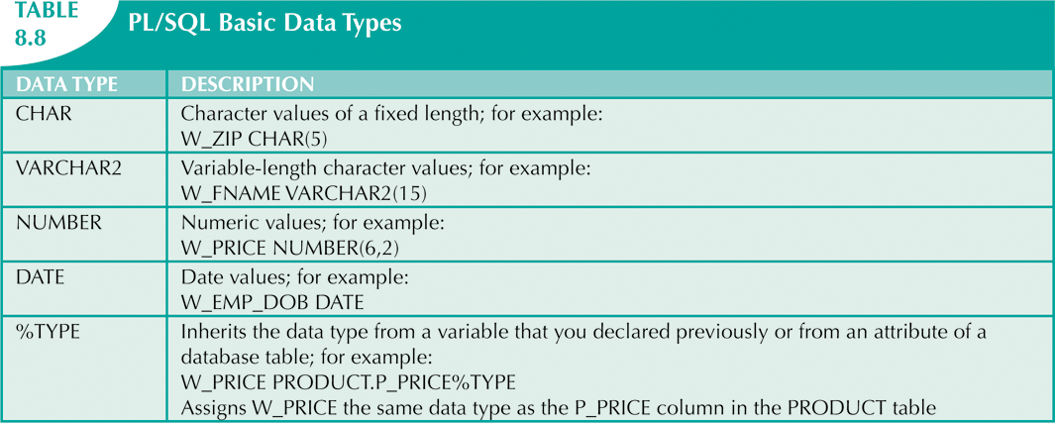
Database Systems, 10th Edition

Slide 54
Triggers
Procedural SQL code automatically invoked by RDBMS on data manipulation event
Trigger definition:
  Triggering timing: BEFORE or AFTER
  Triggering event: INSERT, UPDATE, DELETE
  Triggering level:
    Statement-level trigger
    Row-level trigger
  Triggering action
DROP TRIGGER trigger_name
Database Systems, 10th Edition

Slide 55
Stored Procedures
Named collection of procedural and SQL statements
Advantages
  Substantially reduce network traffic and increase performance
    No transmission of individual SQL statements over network
  Reduce code duplication by means of code isolation and code sharing
    Minimize chance of errors and cost of application development and maintenance
Database Systems, 10th Edition

Slide 56
PL/SQL Processing with Cursors
Cursor: special construct in procedural SQL to hold data rows returned by SQL query
Implicit cursor: automatically created when SQL returns only one value
Explicit cursor: holds the output of an SQL statement that may return two or more rows
Cursor-style processor retrieves data from cursor one row at a time
  Current row is copied to PL/SQL variables
Database Systems, 10th Edition

Slide 57
PL/SQL Stored Functions
Named group of procedural and SQL statements that returns a value
Syntax:
  CREATE FUNCTION function_name(argument IN data-type, …) RETURN data- type [IS]
  BEGIN
  PL/SQL statements;
  …
  RETURN (value or expression);
  END;
Database Systems, 10th Edition

Slide 58
Embedded SQL
Key differences between SQL and procedural languages:
  Run-time mismatch
    SQL is executed one instruction at a time
    Host language typically runs at client side in its own memory space
  Processing mismatch
    Host language processes one data element at a time
  Data type mismatch
Database Systems, 10th Edition

Slide 59
Embedded SQL (cont’d.)
Embedded SQL framework defines:
  Standard syntax to identify embedded SQL code within host language
  Standard syntax to identify host variables
  Communication area exchanges status and error information between SQL and host language
Database Systems, 10th Edition

Slide 60
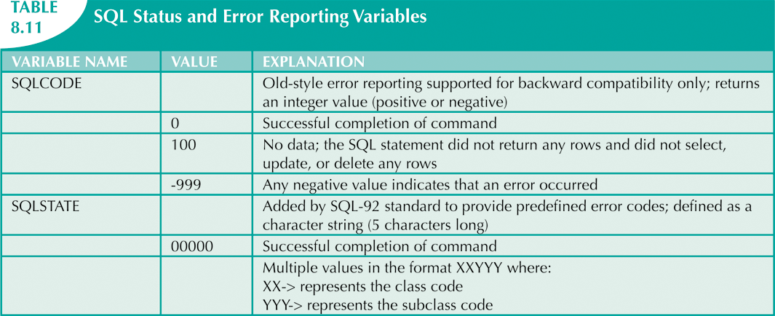
Database Systems, 10th Edition

Slide 61
Embedded SQL (cont’d.)
Static SQL
  Embedded SQL in which programmer uses predefined SQL statements and parameters
    End users of programs are limited to actions that were specified in application programs
  SQL statements will not change while application is running
Database Systems, 10th Edition

Slide 62
Embedded SQL (cont’d.)
Dynamic SQL
  SQL statement is not known in advance, but instead is generated at run time
  Program can generate SQL statements at run-time that are required to respond to ad hoc queries
  Attribute list and condition are not known until end user specifies them
  Tends to be much slower than static SQL
  Requires more computer resources
Database Systems, 10th Edition

Slide 63
Summary
Operations that join tables are classified as inner joins and outer joins
Natural join returns all rows with matching values in the matching columns
  Eliminates duplicate columns
Subqueries and correlated queries process data based on other processed data
Most subqueries are executed in serial fashion
SQL functions are used to extract or transform data
Database Systems, 10th Edition

Slide 64
Summary (cont’d.)
Relational set operators combine output of two queries to generate new relation
Oracle sequences may be used to generate values to be assigned to a record
PL/SQL can be used to create triggers, stored procedures, and PL/SQL functions
A stored procedure is a named collection of SQL statements
Database Systems, 10th Edition

Slide 65
Summary (cont’d.)
When SQL statements return more than one value inside the PL/SQL code, cursor is needed
Embedded SQL uses SQL statements within an application programming language
Database Systems, 10th Edition

